Slide 1

Lending Club Case Study:
Assessment By: Divakar & Vivek

Slide 2
OBJECTIVE
Identify the driving factors (or driver variables) behind loan default

Slide 3
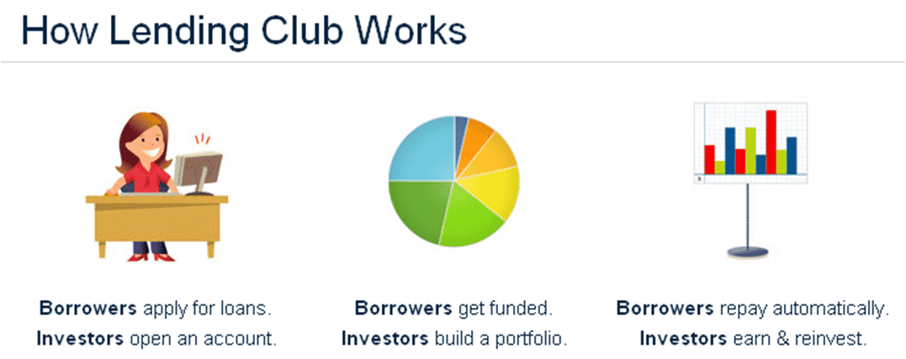
Lending Club: In Brief
What is Lending Club?
Lending Club is a marketplace for personal loans that matches borrowers who are seeking a loan with investors looking to lend money and make a return.
When the company receives a loan application, the company has to make a decision for loan approval based on the applicant’s profile. Two types of risks are associated with the bank’s decision:
If the applicant is likely to repay the loan, then not approving the loan results in a loss of business to the company
If the applicant is not likely to repay the loan, i.e. he/she is likely to default, then approving the loan may lead to a financial loss for the company
If one can identify these risky loan applicants, then such loans can be reduced thereby cutting down the amount of credit loss.
Identification of such applicant’s using EDA is the aim of this case study

Slide 4
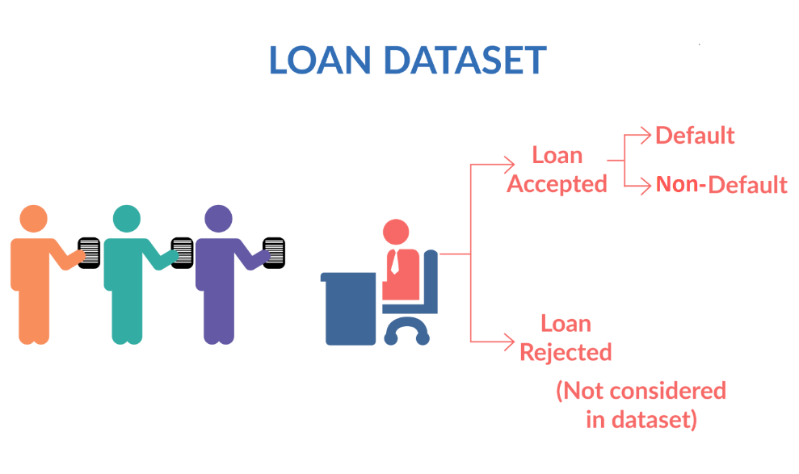
Lending Club: Loan Status
Fully paid: Applicant has fully paid the loan (the principal and the interest rate)
Current: Applicant is in the process of paying the instalments, i.e. the tenure of the loan is not yet completed. These candidates are not labelled as 'defaulted'.
Charged-off: Applicant has not paid the instalments in due time for a long period of time, i.e. he/she has defaulted on the loan

Slide 5
Lending Club: Dataset Loan Parameters
loan_amnt : Amount applied by potential borrowers
funded_amnt: Amount recommended/approved by Lending Club
funded_amnt_inv : Amount funded by investors
dti: Debt to Income ratio
grade: loan classification based on interest rate
purpose: purpose of loan such as car, house, vacation..etc
installment: monthly EMI amount
loan_status: status of the loan Fully Paid/Charged Off/Current
annual_inc: yearly income of the loan applicant
int_rate: rate of interest of the availed loan
emp_length: work experience of the loan applicant
verification_status: income verification status of the loan applicant
home_ownership: loan applicant home ownership status
issue_d: date of issue of loan
term: loan repayment EMI number of months

Slide 6
Lending Club: Calculated Parameters
year: year in which loan was applied. Extracted from “issue_d”
month: month in which loan was applied. Extracted from “issue_d”
monthly_inc: monthly income of the loan applicant. Calculated by “annual_inc”/12
netcash_monthly: Net cash available with loan applicant after repaying debt monthly in percentage.
netcash_monthly=
(monthly_inc- installment- (dti*monthly_inc)/100)*100/ monthly_inc
emp_exper : loan applicant work experience category. Calculated from “emp_length”.
emp_length (0 – 2yrs) :Beginner
emp_length (3 – 5yrs) :Junior
emp_length (6 – 9yrs) :Senior
emp_length (>=10yrs) :VSenior

Slide 7
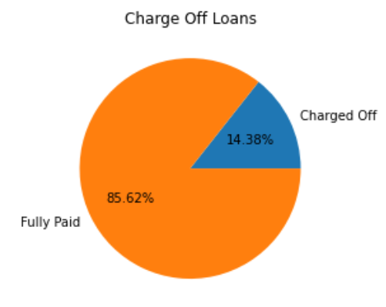
Lending Club: Total Charged Off Loans
Total Loans from the dataset: 39717
“Fully Paid” Loans: 32950
“Charged Off” Loans: 5627
“Current” Loans: 1140

Slide 8
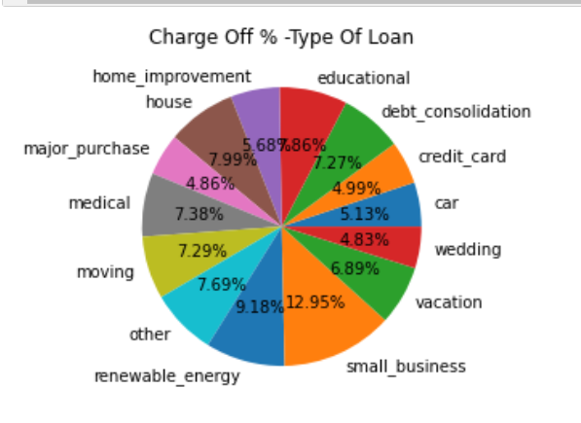
Lending Club: Defaulter %- On Loan Types
Looking at the defaulter’s distribution based on their loan’s availed
“Small_business” type of loan contributes the highest % of defaulters
Followed by “renewable_energy”
House, educational, other, medical, moving, debt_consolidation, & vacation type of loans show similar % defaulters
In terms of volume, “debt_consolidation” loan contributes to nearly 49.2% of defaulters

Slide 9
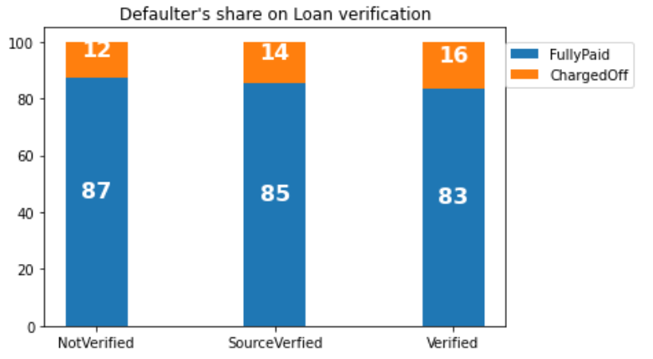
Lending Club: Defaulter %- On Loan verfication status
Loans applicant’s income are usually verified, and status is categorized as Verified, Not Verified and Source Verified
According to the income verification status, when we plot the defaulter’s distribution, we can’t see much difference between “Verified” & “Not Verified” loans.
The trend shows slightly reverse belief. Instead of “Verified” , “Not-Verified” loans has slightly high defaulters.

Slide 10
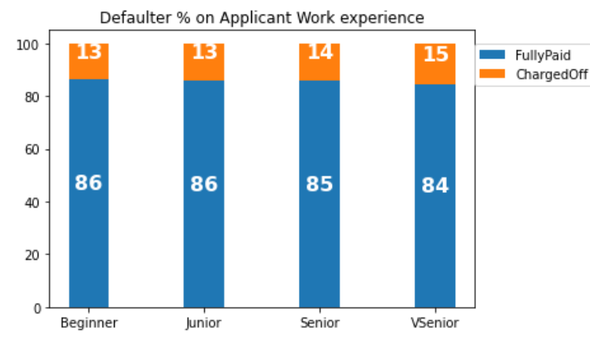
Lending Club: Defaulter %- On Loan Applicant Experience
Based on applicant’s employment length they are grouped as Beginners Junior, Senior and VSenior. When we plot the defaulter’s % distribution based on work experience
We don’t see much difference in the applicant defaulting behavior based on their experience.
We expected a lower defaulting % with increasing experience, but the results are slightly reverse

Slide 11
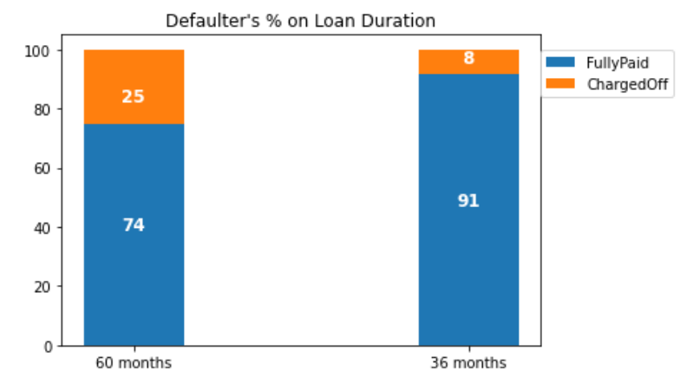
Lending Club: Defaulter %- On Loan Duration
The applicant can choose between 60-month term loan or 36-month term loan. When we plot the defaulter’s % distribution based on the loan term
We see 300% more defaulters in 60 months loan when compared to 36 months loan.

Slide 12
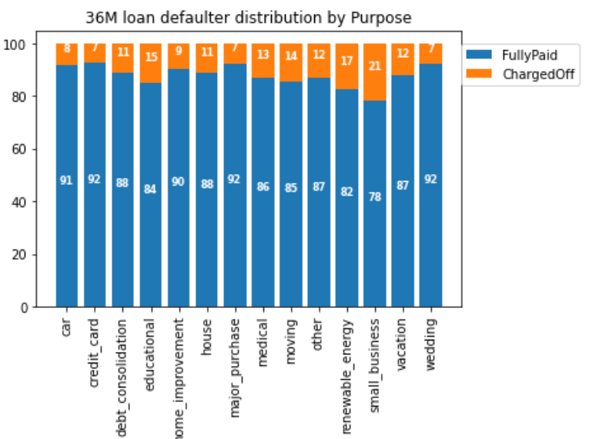
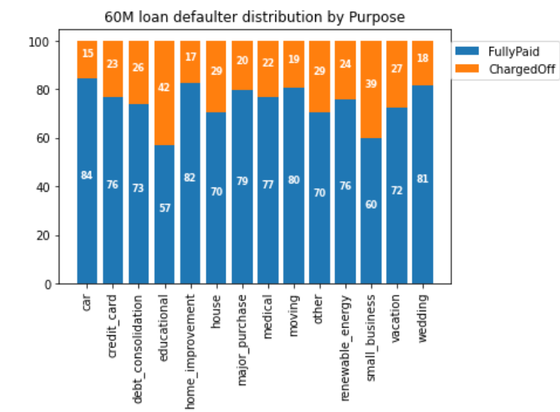
Lending Club: Defaulter %- On Loan Duration & Purpose
When we perform bivariate analysis on loan defaulter w.r.t loan term and loan purpose, we can understand the following
On an average loan defaulters in 60-month term is twice/thrice that of 36-month loan irrespective of the purpose of the loan
Educational and Small business type of loan has the highest % of defaulter

Slide 13
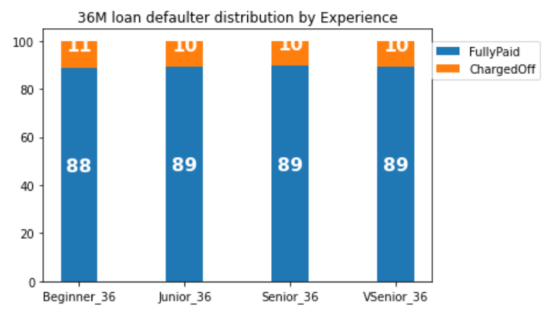
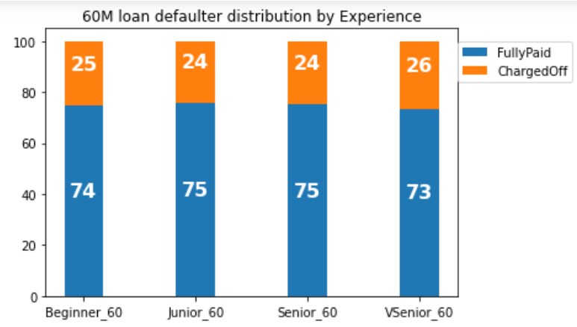
Lending Club: Defaulter %- On Loan Duration & Experience
When we perform bivariate analysis on loan defaulter w.r.t loan term and applicant experience, we can understand the following
On an average loan defaulters in 60-month term is twice/thrice that of 36-month loan irrespective of the loan applicant experience

Slide 14
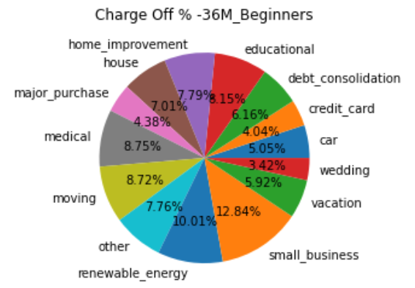
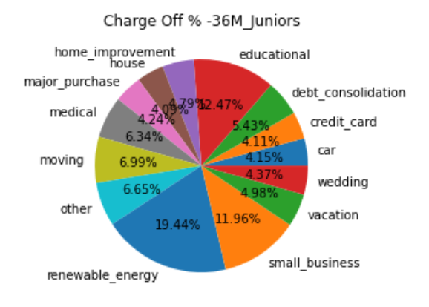
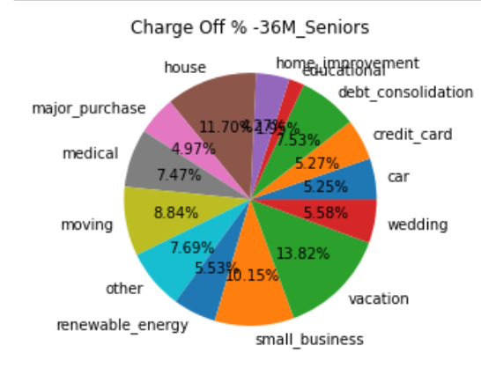
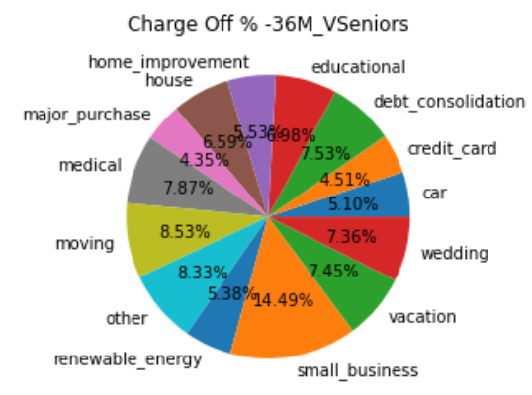
Multivariate Analysis on 36M-Defaulter % - Loan Term, Experience & Purpose
36 month loan defaulter’s
“Renewable Energy” loan contributes max % of defaulters in Beginners and Juniors
Defaults in “Small_business” loans are highest in all experience
Seniors seems to default more in housing loan & and vacation loan.

Slide 15
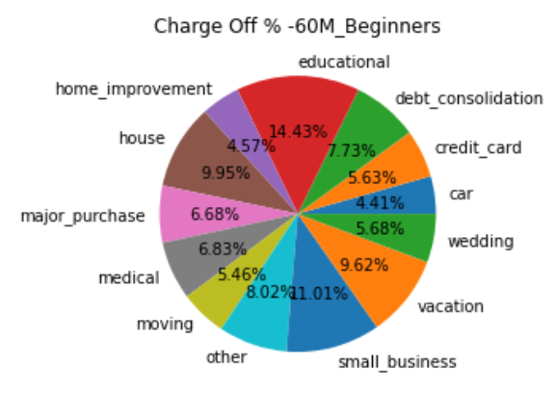
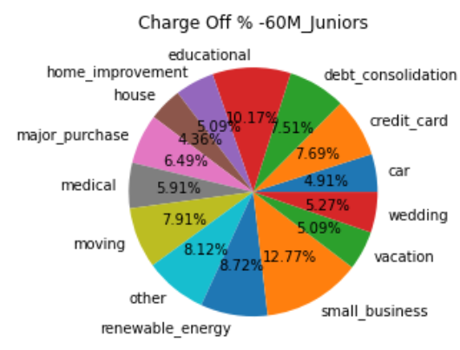
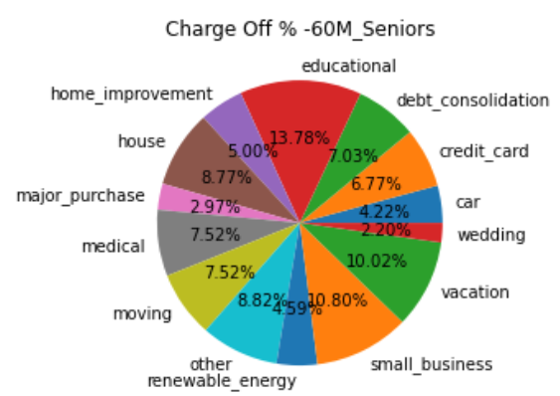
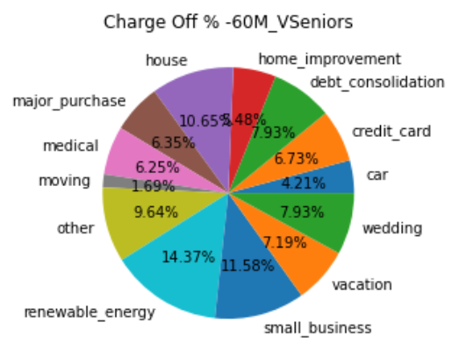
Multivariate Analysis on 60M-Defaulter % - Loan Term, Experience & Purpose
60- month loan defaulter’s
“Educational” loan contributes max % of defaulters in Beginners, Juniors and seniors
Defaults in “Small_business” loans are highest in all experience
Seniors seems to default more in housing loan & and vacation loan.
Vseniors seems to default more on renewable energy and house

Slide 16
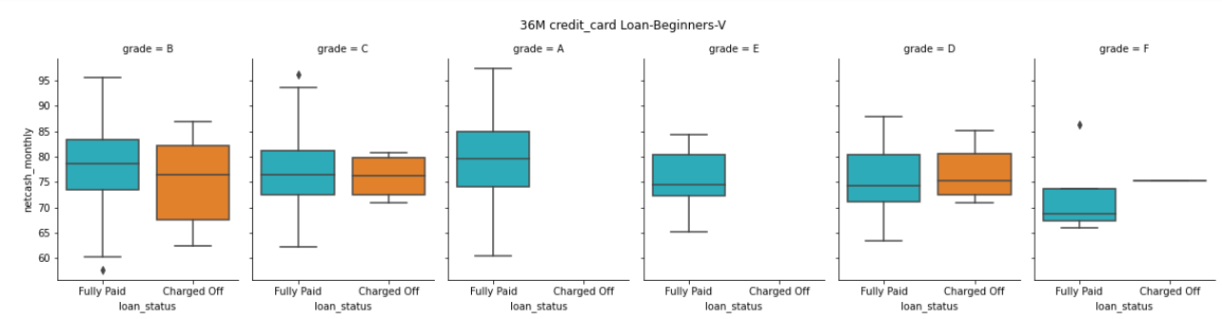
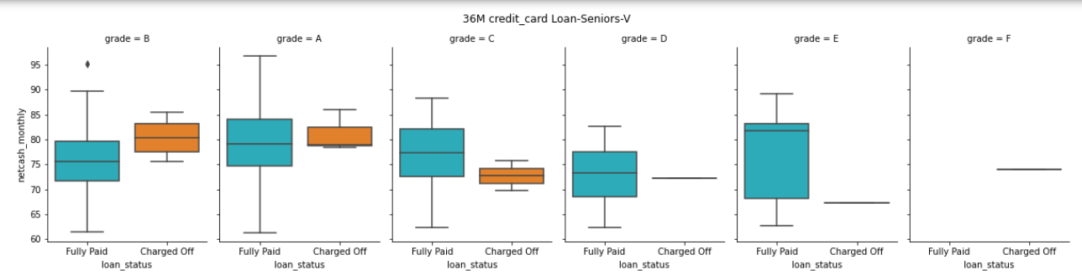
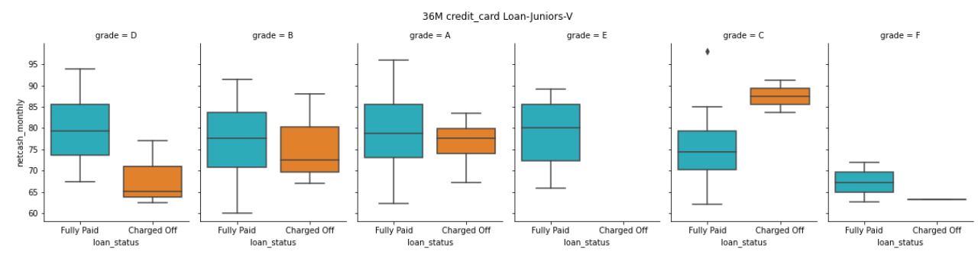
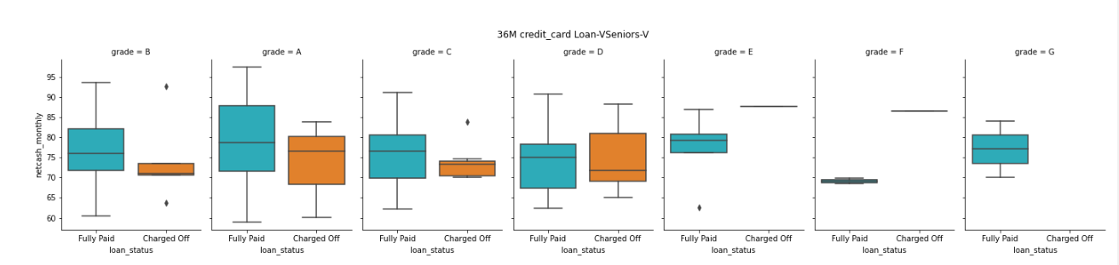
Multivariate Analysis: 36M- Verified Credit Card Loan
High possibility of default:
Beginners availing “B” grade loan and posses “net cash/month” <75%
Juniors availing “D” grade loan and posses “net cash/month” <70%
Seniors availing “C” grade loan and posses “net cash/month” <72%
Vseniors availing “A” grade loan and posses “net cash/month” <72%

Slide 17
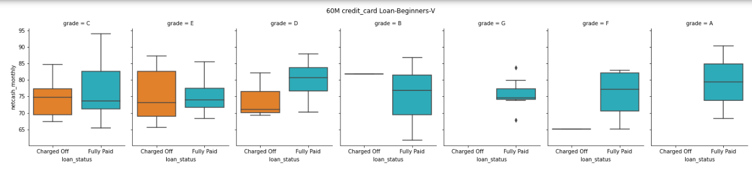
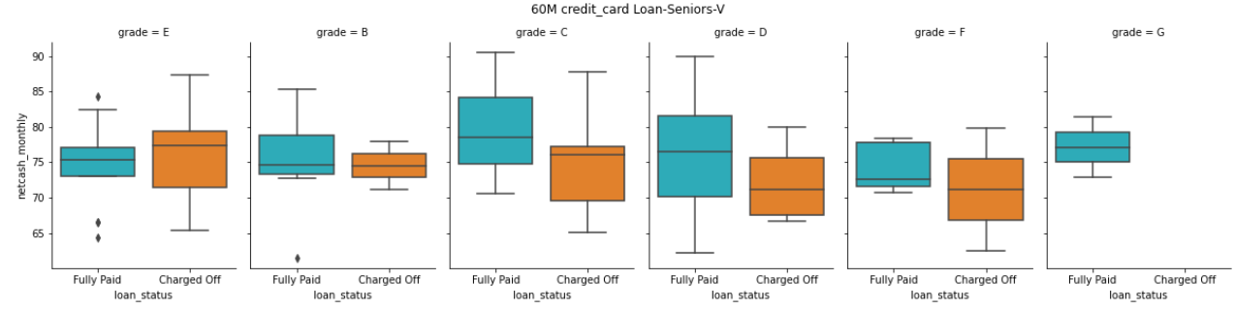
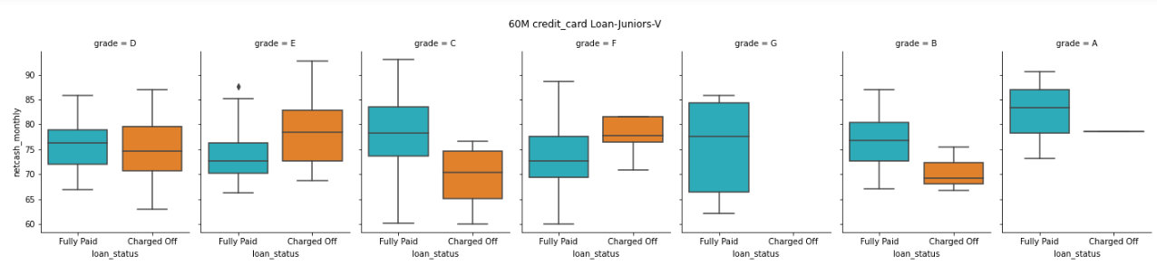
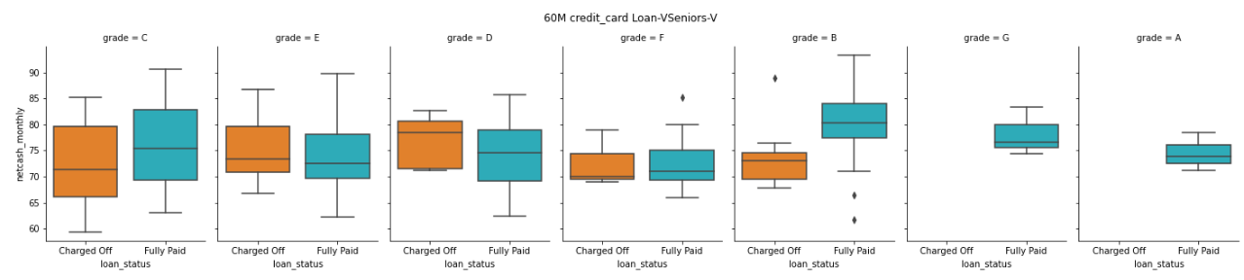
Multivariate Analysis: 60M- Verified Credit Card Loan
High possibility of default:
Beginners availing “C/D/E” grade loan and posses “net cash/month” <72%
Juniors availing “B/C/D” grade loan and posses “net cash/month” <72%
Seniors availing “C/D/E/F” grade loan and posses “net cash/month” <70%
Vseniors availing “C” grade loan and posses “net cash/month” <70%

Slide 18
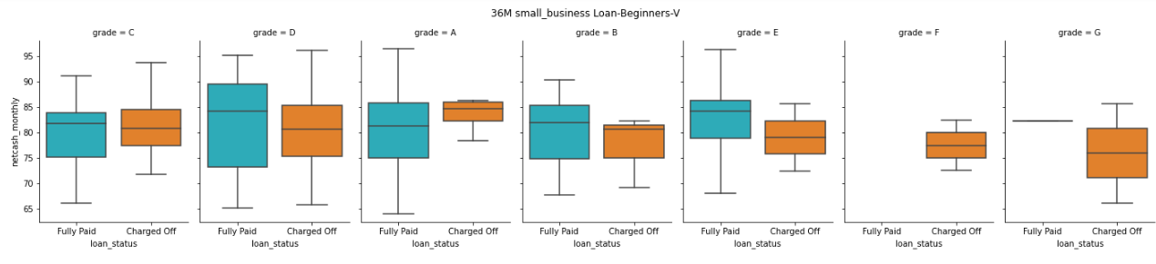
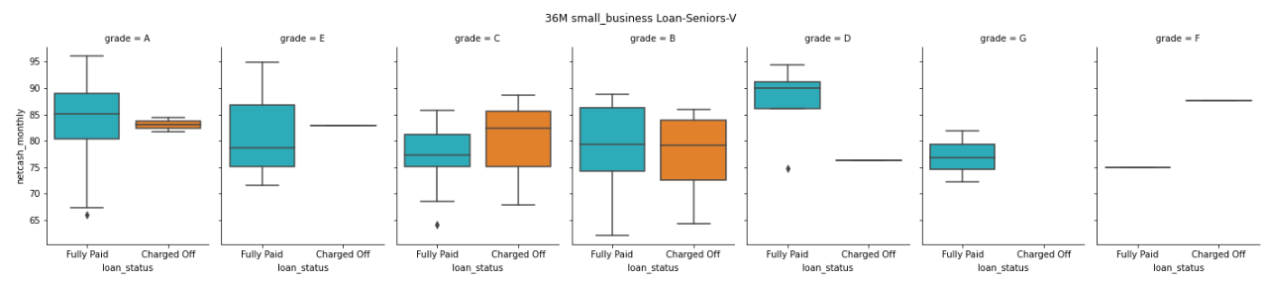
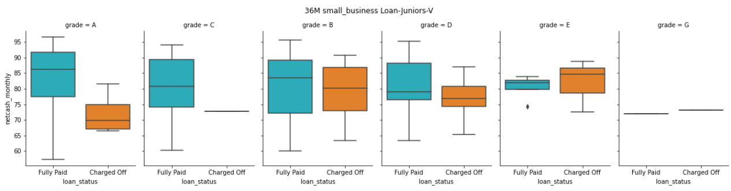
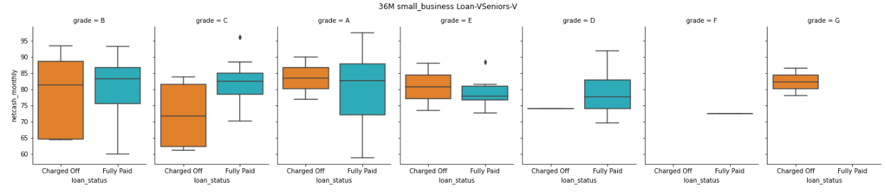
Multivariate Analysis: 36M- Verified SmallBusiness Loan
High possibility of default:
Beginners availing “E/F/G” grade loan and posses “net cash/month” <80%
Juniors availing “A” grade loan and posses “net cash/month” <75%
Seniors availing “B” grade loan and posses “net cash/month” <75%
Vseniors availing “B/C/G” grade loan and posses “net cash/month” <75%

Slide 19
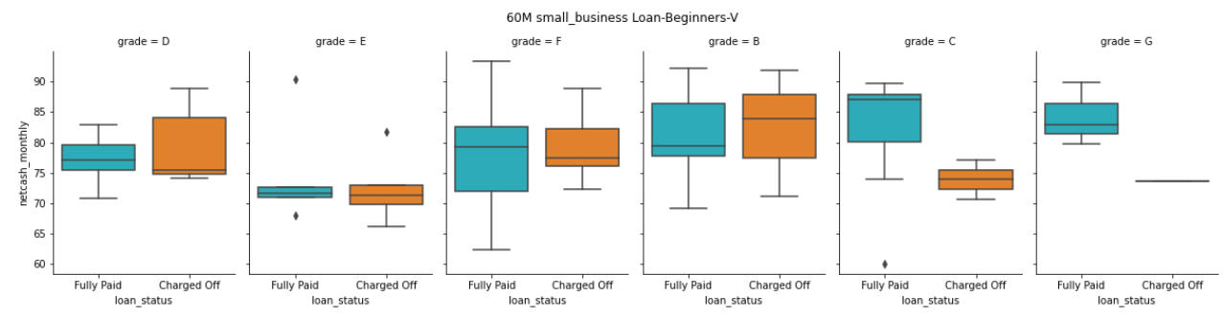
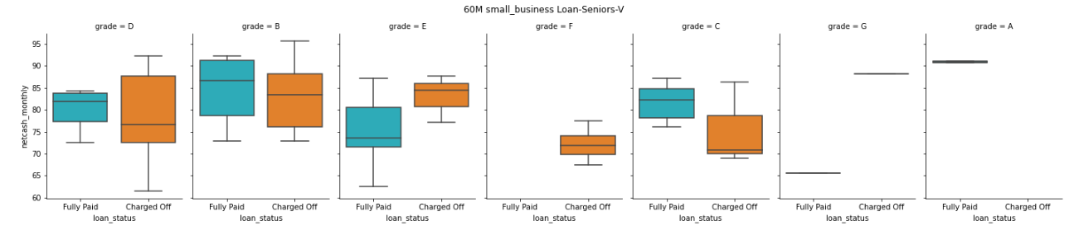
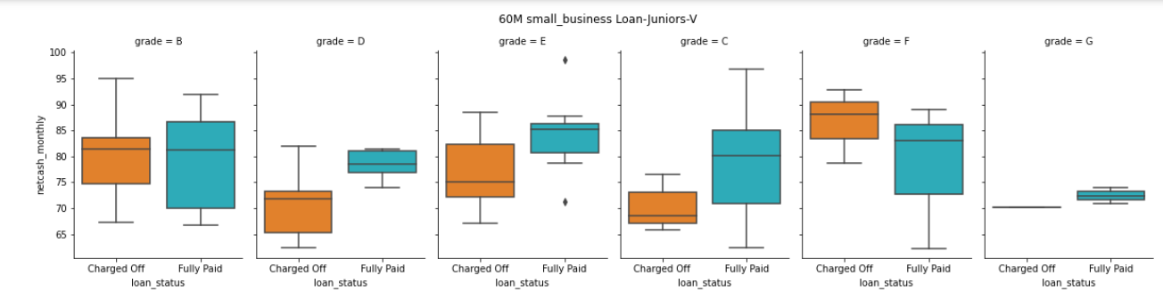
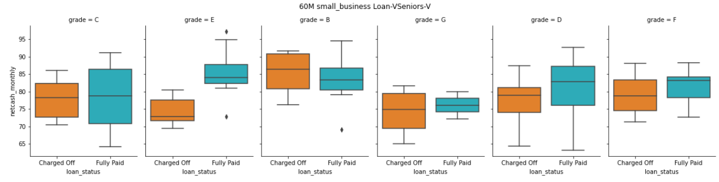
Multivariate Analysis: 60M- Verified SmallBusiness Loan
High possibility of default:
Beginners availing “C” grade loan and posses “net cash/month” <75%
Juniors availing “C/D/E” grade loan and posses “net cash/month” <70%
Seniors availing “B/C/D” grade loan and posses “net cash/month” <77%
Vseniors availing “D/E/F/G” grade loan and posses “net cash/month” <70%

Slide 20
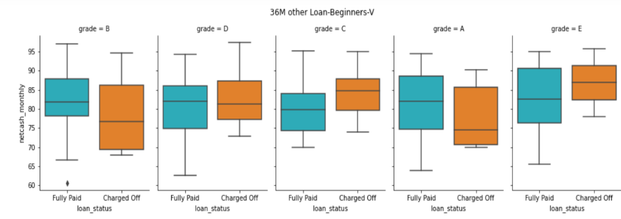
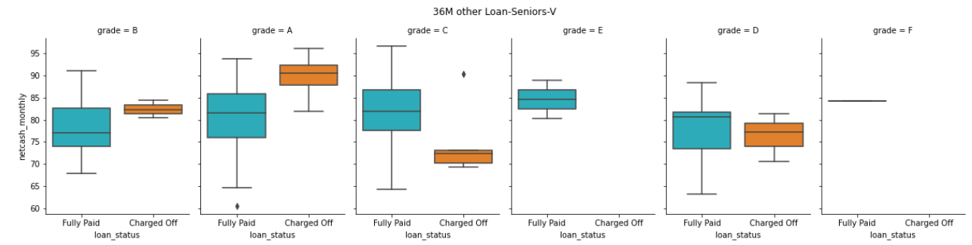
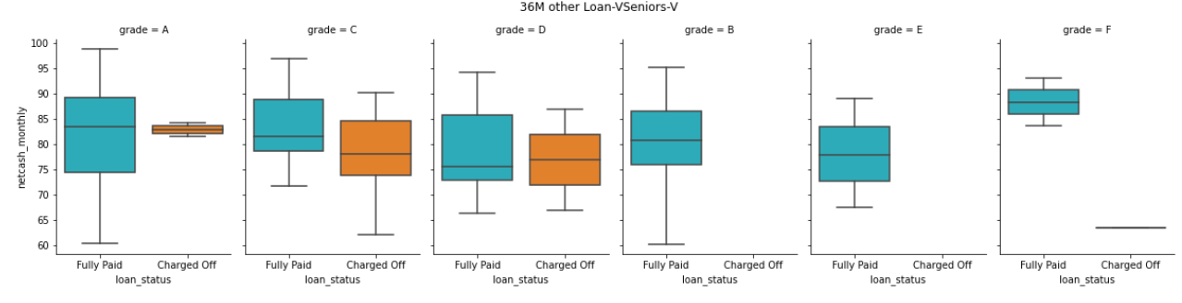
Multivariate Analysis: 36M- Verified Other Loan
High possibility of default:
Beginners availing “A/B” grade loan and posses “net cash/month” <75%
Seniors availing “C” grade loan and posses “net cash/month” <72%
Vseniors availing “D” grade loan and posses “net cash/month” <72%

Slide 21
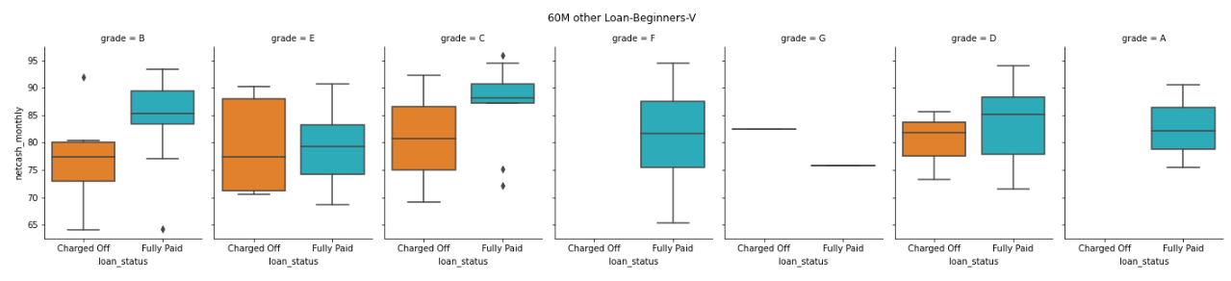
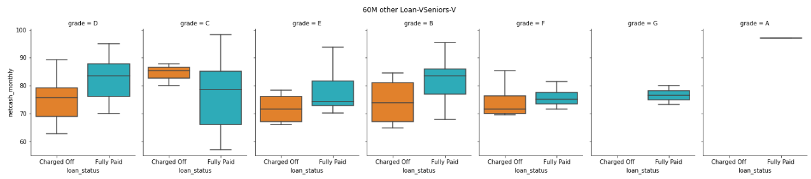
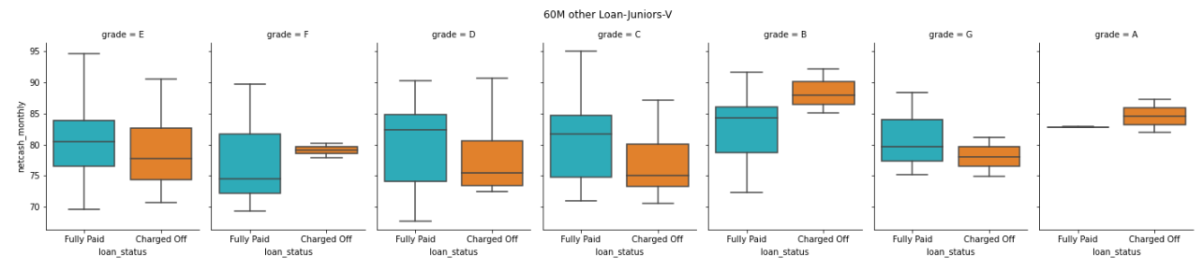
Multivariate Analysis: 60M- Verified Other Loan
High possibility of default:
Beginners availing “B/C/E” grade loan and posses “net cash/month” <75%
Juniors availing “C/D/E/G” grade loan and posses “net cash/month” <74%
Seniors availing “C” grade loan and posses “net cash/month” <72%
Vseniors availing “B/D/E/F” grade loan and posses “net cash/month” <72%

Slide 22
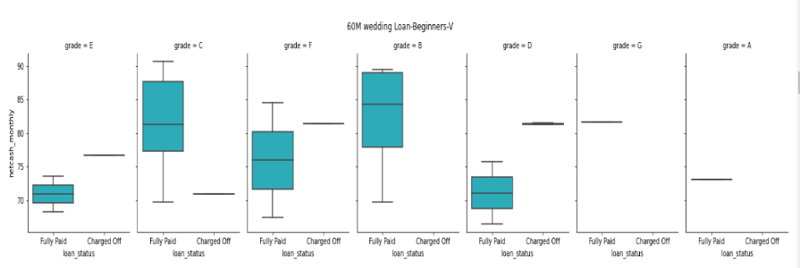
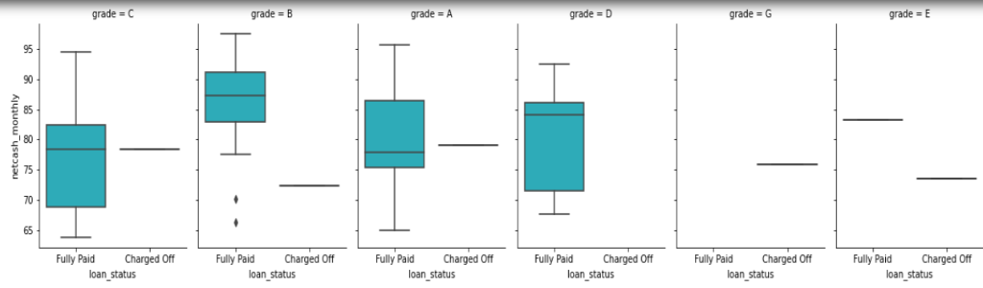
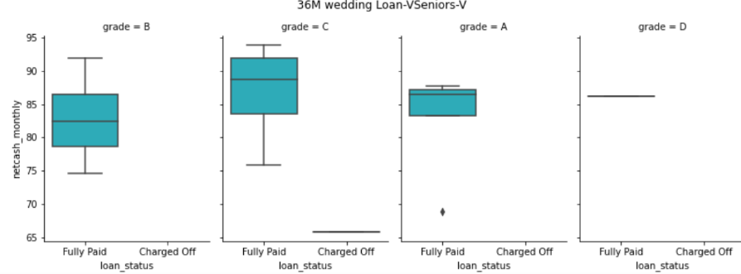
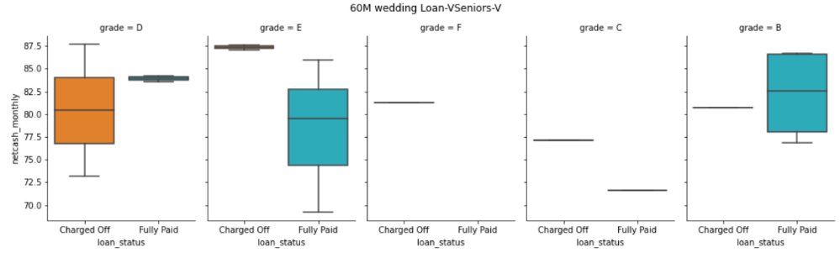
Multivariate Analysis: 36/60M- Verified Wedding Loan
High possibility of default:
Except Vseniors availing grade “D” loan, all others are not likely to default in wedding loan.
Vseniors availing grade “D” loan and possess “net cash/month” <83% most likely to default

Slide 23
Multivariate Analysis: 60M- Verified Wedding Loan
High possibility of default:
Beginners availing “B/C/E” grade loan and posses “net cash/month” <75%
Juniors availing “C/D/E/G” grade loan and posses “net cash/month” <74%
Seniors availing “C” grade loan and posses “net cash/month” <72%
Vseniors availing “B/D/E/F” grade loan and posses “net cash/month” <72%

Slide 24
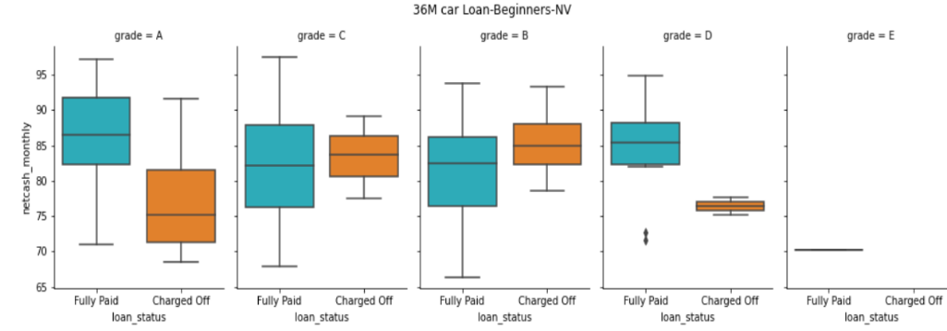
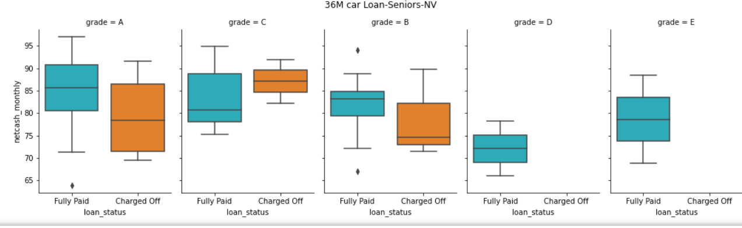
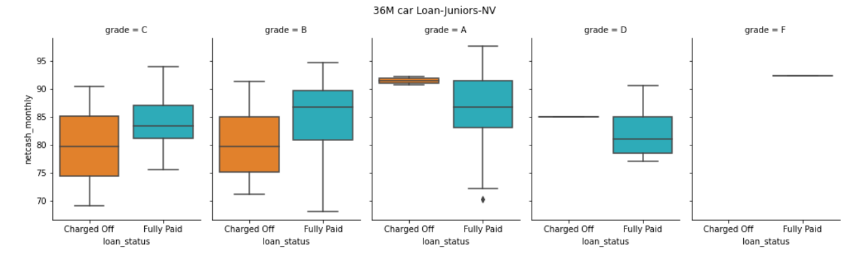
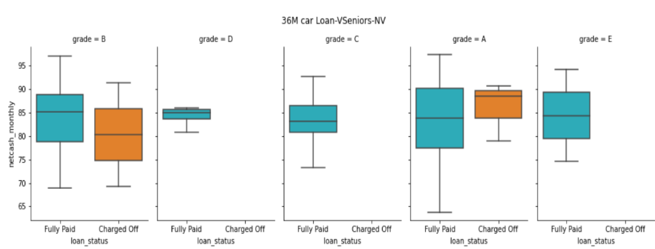
Multivariate Analysis: 36M- Car Loan
High possibility of default:
Most of the defaults are in Not-Verified category in grade “A/B/C” loans
Seniors availing “C” grade loan and posses “net cash/month” <73% are likely to default

Slide 25
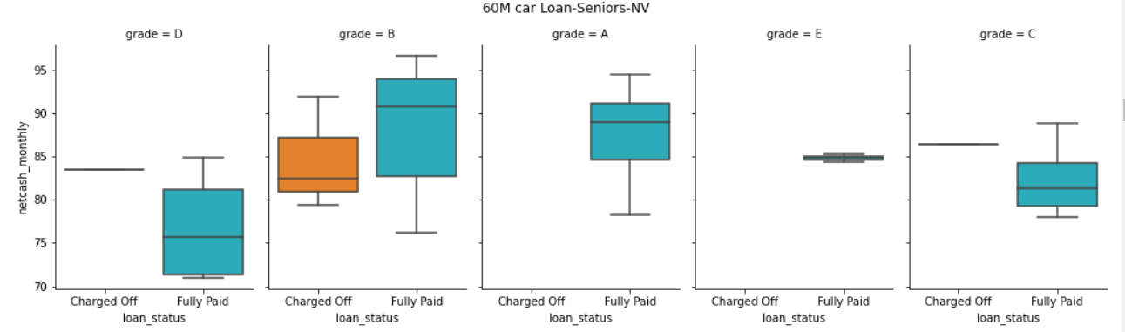


Multivariate Analysis: 60M- Car Loan
High possibility of default:
Most of the defaults are in Not-Verified category in grade “B/D” loans

Slide 26




Multivariate Analysis: 36M- Debit Consolidation Loan
High possibility of default:
Beginners availing “A/B” grade loan and posses “net cash/month” <73%
Juniors availing “A/B/C” grade loan in Not Verified category and posses “net cash/month” <73%
Seniors availing “A/B/C” grade loan and posses “net cash/month” <73%
VSeniors availing grade “C/D” and posses “net cash/month” <70%

Slide 27




Multivariate Analysis: 60M- Debit Consolidation Loan
High possibility of default:
Beginners availing loan and posses “net cash/month” <70%
Juniors availing “C/D/F/G” grade loan and posses “net cash/month” <70%
Seniors availing “B/D” grade loan and posses “net cash/month” <7%2
VSeniors availing grade “C/E/F” and posses “net cash/month” <70%

Slide 28




Multivariate Analysis: 36M- Home Improvement Loan
High possibility of default:
Beginners availing “A/B/C/D” grade loan and posses “net cash/month” <82%
Juniors availing “A” grade loan and posses “net cash/month” <82%
Seniors availing home improvement loan not likely to default
VSeniors availing grade “A/B/C” loan and posses “net cash/month” <75%

Slide 29




Multivariate Analysis: 60M- Home Improvement Loan
High possibility of default:
Beginners availing “C/D” grade loan and posses “net cash/month” <78%
Juniors availing “C/D” grade loan and posses “net cash/month” <78%
Seniors availing “D” grade loan and posses “net cash/month” <72%
VSeniors availing grade “C/D” loan and posses “net cash/month” <78%

Slide 30




Multivariate Analysis: 36M-Major Purchase Loan
High possibility of default:
Beginners availing “A/B/D” grade loan and posses “net cash/month” <78%
Juniors availing “C/D/E” grade loan and posses “net cash/month” <75%
Seniors availing home improvement loan not likely to default
VSeniors availing grade “B” loan and posses “net cash/month” <75%

Slide 31




Multivariate Analysis: 60M-Major Purchase Loan
High possibility of default:
Beginners availing “C” grade loan and posses “net cash/month” <70%
Juniors availing “B” grade loan and posses “net cash/month” <85%
Seniors availing “C” grade loan and posses “net cash/month” <82%
VSeniors availing grade “D” loan and posses “net cash/month” <80%

Slide 32




Multivariate Analysis: 36M-Medical Loan
High possibility of default:
Beginners availing “B” grade loan and posses “net cash/month” <78%
Verified juniors, seniors and vseniors are not likely to defaul
Most of the defaulters in medical loan are in Not-Verified category

Slide 33



Multivariate Analysis: 60M-Medical Loan
High possibility of default:
Verified beginners, juniors and seniors are not likely to default
Most of the defaulters in medical loan are in Not-Verified category
Vseniors availing grade “C” loan and posses “net cash/month” <70%

Slide 34



Multivariate Analysis: 36/60M-Moving Loan
High possibility of default:
Most of the Verified loan applicants are not likely to default
Most of the defaulters in moving loan are in Not-Verified category

Slide 35




Multivariate Analysis: 36/60M-Vacation Loan
High possibility of default:
Most of the Verified loan applicants are not likely to default
Most of the defaulters in vacation loan are in Not-Verified category

Slide 36




Multivariate Analysis: 36/60M-House Loan
High possibility of default:
Most of the Verified loan applicants are not likely to default
60M loan availed by Juniors under grade “C” loan is likely to default under 70% net cash%
60M loan availed by Vseniors under grade “E” loan is likely to default

Slide 37


Multivariate Analysis: 36/60M-Educational Loan
High possibility of default:
Most of the loan applicants are not likely to default
Juniors availing loan under grade “B” is likely to default under 78% net cash%

Slide 38


Multivariate Analysis: 36/60M-Renewable Energy Loan
High possibility of default:
Most of the verified loan applicants are not likely to default
Most likely defaulters of RE loans are in Not Verified category

Slide 39
Thank You!

